Slide 1
Step Into Java:
Heaps/Priority Queues part deux
Mr. Neat

Slide 2
What’s Next?
A heap is an efficient data structure to implement a priority queue.
Use an array to implement a heap binary tree that will be used to implement the priority queue interface….Wow!

Slide 3
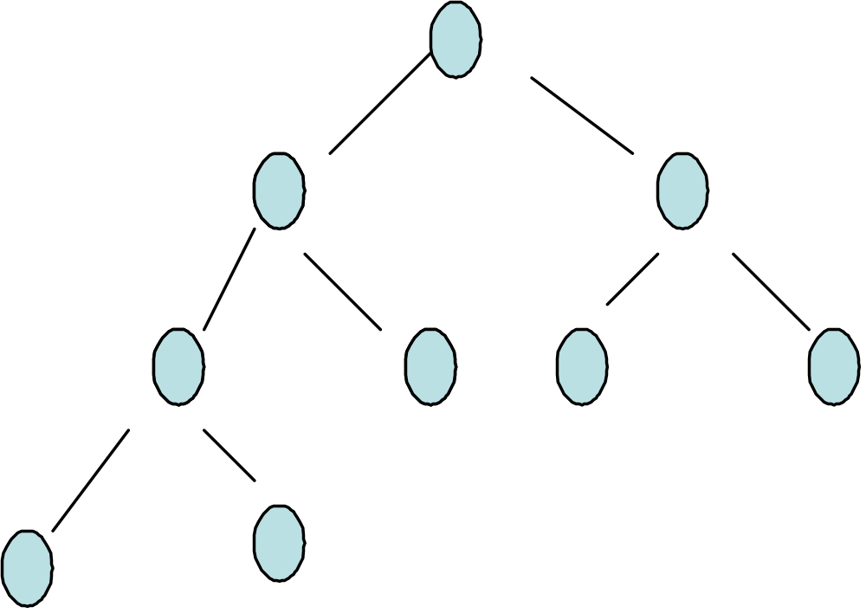
Recall a complete BT…
1
2
3
4
5
6
7
8
9

Slide 4
The best way to program a heap is using an array representation of a complete binary tree.
Assume the array holds Objects
The zero^{th} position is null.
The first is the root node.

Slide 5
Recall a complete BT…
Since the tree is “complete”, the node number tells us
exactly where to find it.
The left and right children of node k, are 2*k and 2*k+1.
The node k parent has the number k/2.
This property allows us to store the tree in an array.
0
1
2
3
4
5
6
7
8
9
null

Slide 6
Given the HeapPriorityQueue class which implements the
PriorityQueue interface:
- write the reheapUp() method
(helper method for adding a node), and
- write the reheapDown() method (helper method for removing the min node).
Lab

